Slide 1
Online Shopping System
18MIS7250-Amit Kumar Sahu
18MIS7284-J.ChandraMouli
18MIS7154-Mohammad.Ruhi Roshanara
18MIS7035-P.Varshini
Prof.Hussain Syed

Slide 2
UML DIAGRAMS FOR ONLINE SHOPPING
TYPES OF UML DIAGRAMS ARE:
USE CASE DIAGRAM
ACTIVITY DIAGRAM
CLASS DIAGRAM
SEQUENCE DIAGRAM
COLLABORATION DIAGRAM
DEPLOPYMENT DIAGRAM

Slide 3
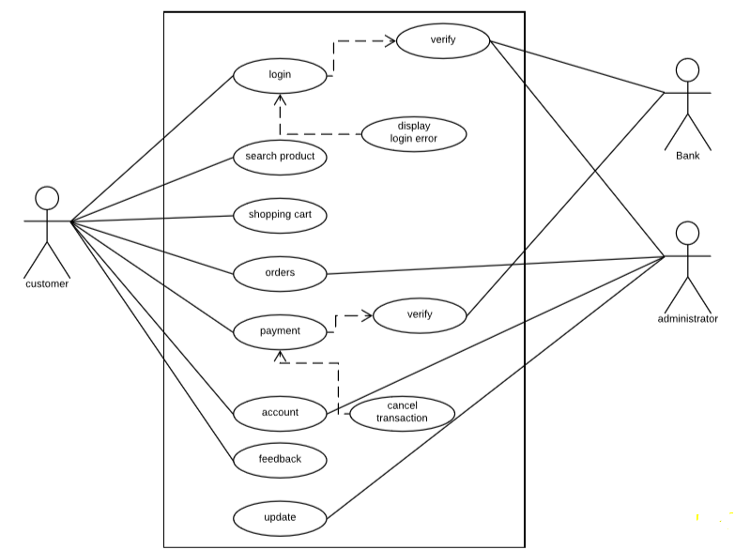
USE CASE DIAGRAM

Slide 4
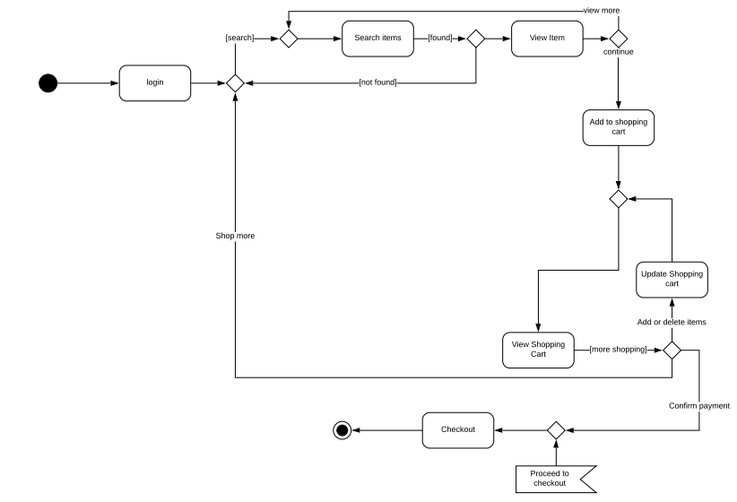
ACTIVITY DIAGRAM

Slide 5
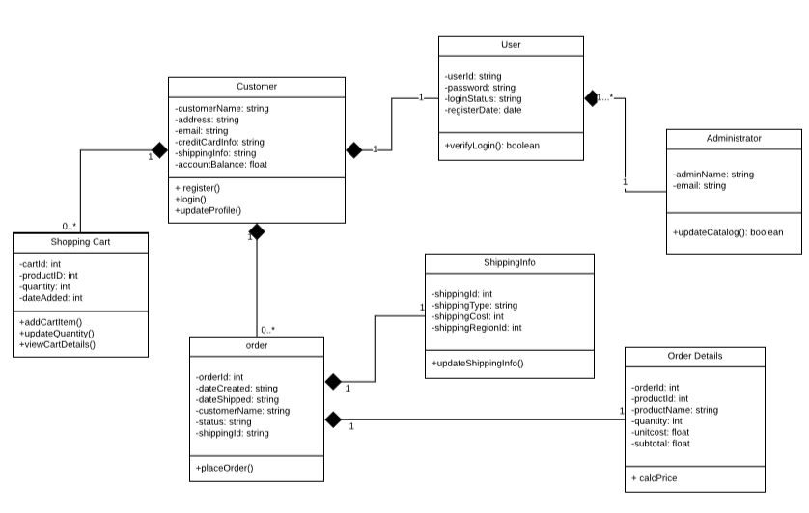
CLASS DIAGRAM

Slide 6
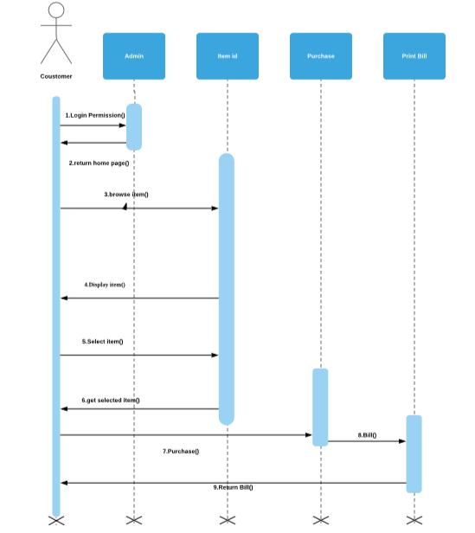
SEQUENCE DIAGRAM

Slide 7
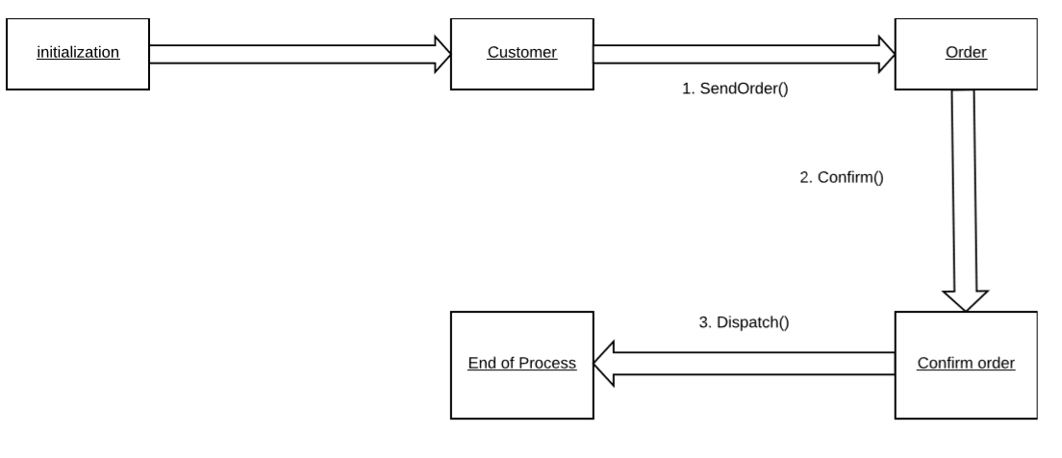
COLLABORATION DIAGRAM

Slide 8
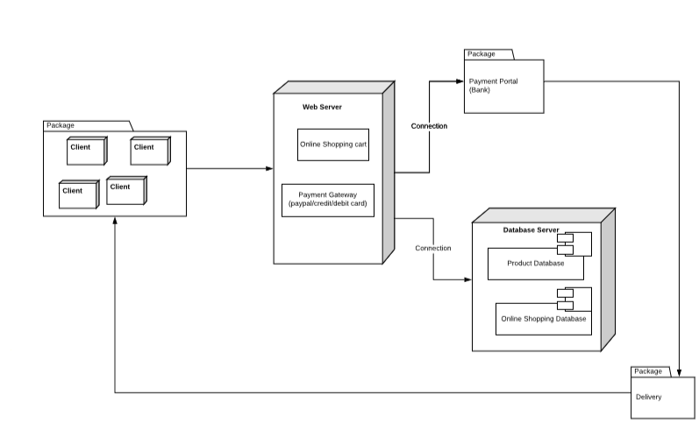
DEPLOYMENT DIAGRAM

Slide 9
THANK YOU

